Slide 1

Web Development 1
© Hugh McCabe & Matt Smith 2008-2014
The CSS Box Model (part 1)
- Borders
- Padding

Slide 2
Introduction
Every element in a HTML document generates a BOX in which the content is housed.
In this lecture we are going to look at :
Borders
Padding

Slide 3
The Element Box

Slide 4
The Element Box
As we have seen, every HTML element, both block-level or inline generates a rectangular element box.
The components of this box are shown below.
Outer Edge
Border
Inner Edge
Margin Area
Padding area
Content area
Height
Width

Slide 5
Padding (space INSIDE border)

Slide 6
Padding
Padding is space between content area and border
Rule of thumb – seriously consider some padding if element has background colour or a visible border
example
p {
padding: 4rem;
background-color: #D098D4;
}

Slide 7
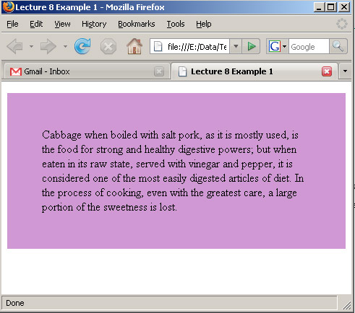
Padding
p {
padding: 4rem;
background-color: #D098D4;
}
padding: 4rem;
Using padding this way adds equal amount of padding on all 4 sides

Slide 8
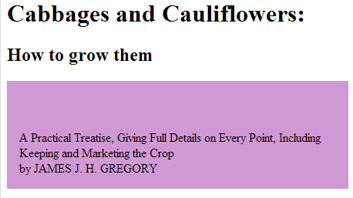
Padding
Individual padding for all 4 sides can be defined:
padding-top padding-right padding-bottom padding-left
p {
padding-top: 4rem;
padding-bottom: 1rem;
padding-left: 1rem;
padding-right: 1rem;
background-color: #D098D4;
}

Slide 9
Borders

Slide 10
border-style
A border is a line drawn around content area and its (optional padding).
8 different border styles and border can be any width or colour we want
border-style
/* most common */
none
solid
/* other values */
dotted | dashed
double | groove | ridge | inset | outset

Slide 11
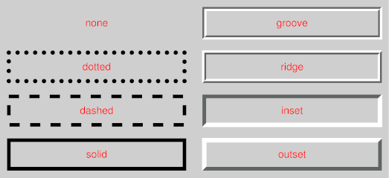
border-style
Image above shows result of applying the different options.

Slide 12
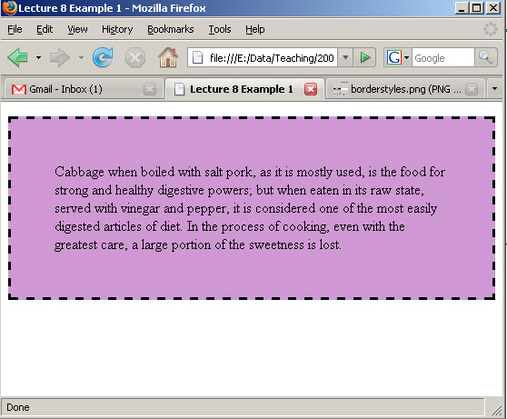
Borders
/* example of adding a border */
p {
border-style: dashed;
background-color: #D098D4;
padding: 2rem;
}

Slide 13
border-[SIDE]-style
You can also specify different border for the top, left, bottom and right of elements.
This is not too common but if you want to, you can do it with these properties:
border-top-style
border-right-style
border-bottom-style
border-left-style

Slide 14
border-width
Border width can be controlled with the border-width property.
You can give this a length unit or use predefined keywords – thin, medium, or thick. Here are some examples:
.help {
border-width: 2rem;
border-style: solid;
width: 30rem;
height: 10rem; }
.banner {
border-width: thin;
border-style: dashed; }

Slide 15
border-color
You can set also specify border colour
This then overrides the inheritance of the foreground (text) color of the element to have a border)
You do this with, you guessed it, the border-color property.
You can give this an RBG value or one of the predefined colour names we talked about previously.
Also border-top-color etc. properties for specifying different colours for top, right, left and bottom borders.

Slide 16
Borders: shorthand rule
Can set width/style/color in a single declaration:
Order does not matter, although most web developers use the order: width style color
E.g.
footer { border: 0.2rem solid red; }
Can also use shorthand rule for individual parts (top, bottom, left, right) of the border, e.g.:
a:hover {
border-top: 0.1rem dashed red;
border-bottom: 0.1rem dashed red;
}

Slide 17
Border radius (rounded corners …)

Slide 18
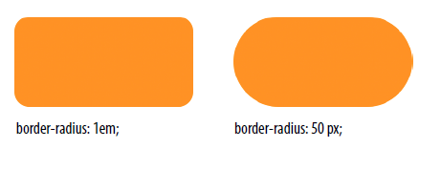
Borders: radius
A curved radius can be defined
The same for all 4 corners
Differently for each corner individually
Length values of REMs, pixels etc. can be used
border-radius: 1rem; /* subtle rounding */
border-radius: 50px; /* very rounded */
(use REMS – this example from older book …)

Slide 19
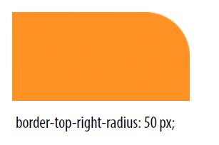
Borders: radius
Changing just one or two corners can be effective
E.g. for ‘tab’ effects etc.
border-top-right-radius: 50px;
(use REMS – this example from older book …)

Slide 20
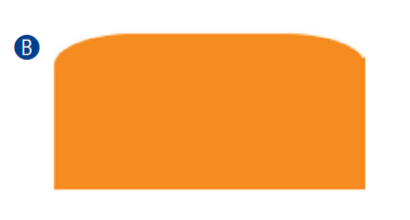
Borders: radius
Can give 2 values
First for horizontal radius
Second for vertical radius
border-top-right-radius: 100px 50px;
border-top-left-radius: 100px 50px;
(use REMS – this example from older book …)
Here we see less vertical curve, but larger horizontal curve

Slide 21
Summary and Conclusions

Slide 22
Summary / Conclusions …
Box model
Spacing and size of elements
Padding
Spacing between content and border
Padding on 4 sides (top/bottom/left/right)
Borders
Line drawn around (content + padding) rectangle
Can get fancy with new properties like border-radius
Design rule of thumb
IF you use border OR background color
THEN defined some padding
REMEMBER – use REMS for all sizing in your pages

